Slide 1

Corona Virus Analysis
By Aman Srivastava
Data Analyst Intern at Mentorness
Batch – MIP-DA-07

Slide 2
Contents
Introduction
Objective
Code
Conclusion

Slide 3
Introduction
"The COVID-19 pandemic has posed unprecedented public health challenges globally. As we continue to combat this virus, leveraging data has become crucial in understanding its spread and the effectiveness of strategies employed to mitigate it."
"Today, I will share insights derived from an extensive dataset that tracks the progression and the impact of the virus. This analysis aims to provide a clearer picture of how COVID-19 has evolved and affected populations worldwide."

Slide 4
objective
This project is designed to test our SQL and data analysis skills in a real-world context.
Dataset:
Description of each column in dataset:
Province: Geographic subdivision within a country/region.
Country/Region: Geographic entity where data is recorded.
Latitude: North-south position on Earth's surface.
Longitude: East-west position on Earth's surface.
Date: Recorded date of CORONA VIRUS data.
Confirmed: Number of diagnosed CORONA VIRUS cases.
Deaths: Number of CORONA VIRUS related deaths.
Recovered: Number of recovered CORONA VIRUS cases.

Slide 5
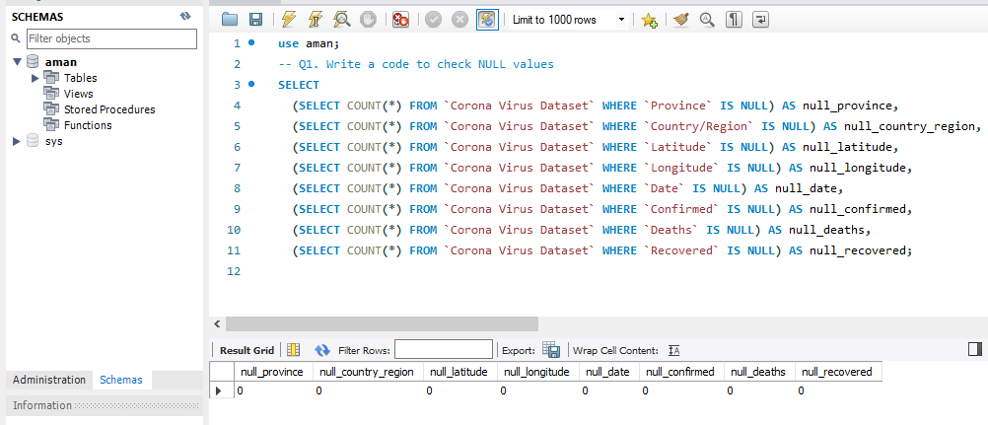
Code(Examples)

Slide 6
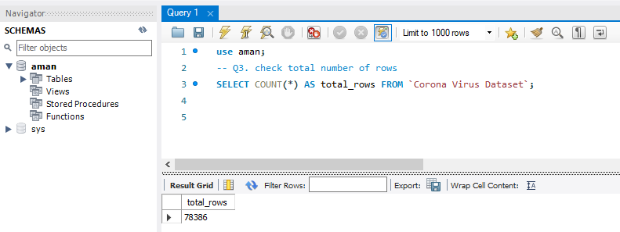

Slide 7
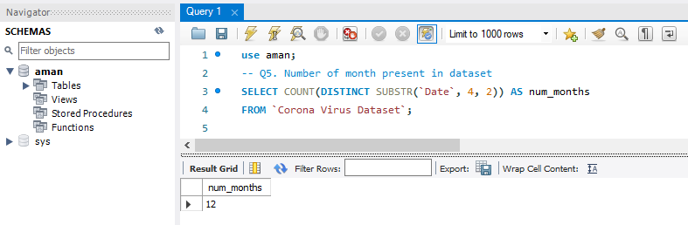

Slide 8
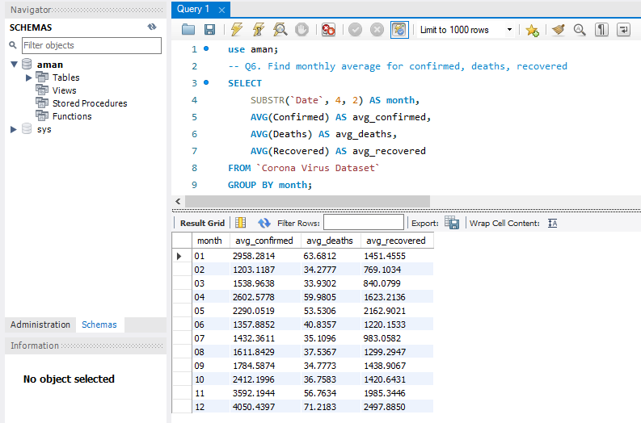

Slide 9
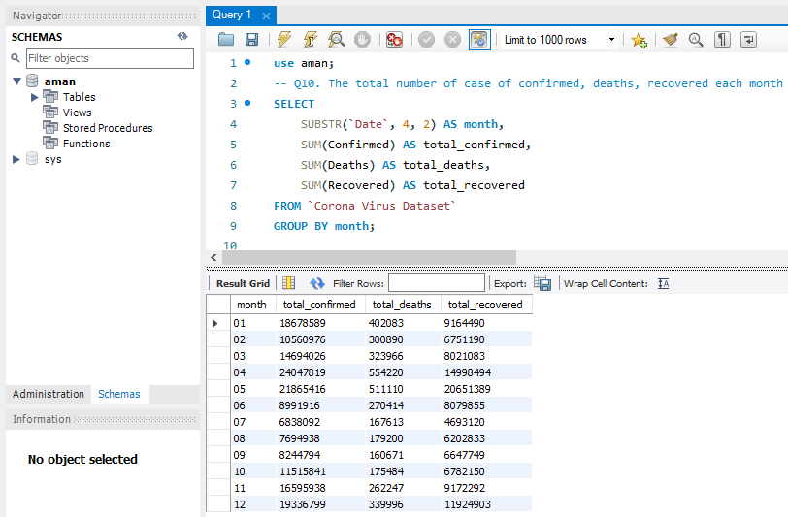

Slide 10
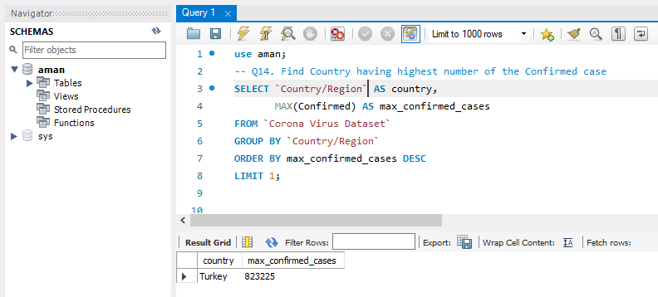

Slide 11
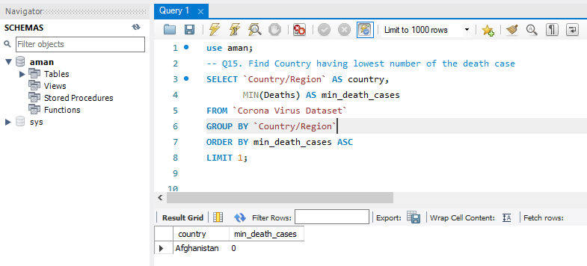

Slide 12
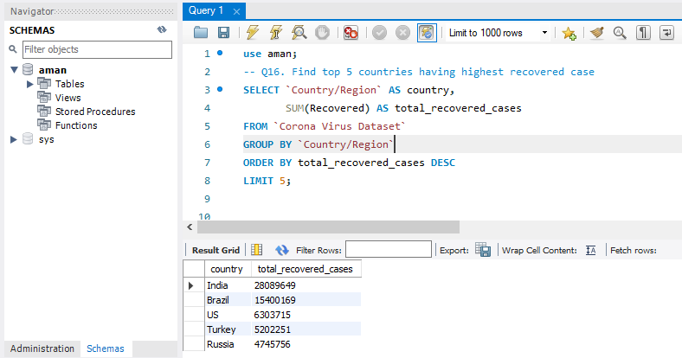

Slide 13


